Slide 1
Procrastination
By Arjun Subash
Notes:
You come home from school, knowing you have several assignments due the next day. You open up your computer, only to find that you haven't even started half of them. "I better start working on this now", you think, and you start typing. Two paragraphs later, you find yourself checking your messages. Your friend has sent you a video. You watch it, and you click then next video in your "Watch Next". Next video, next video, next video. Suddenly, you realize it's 7:00, and you still haven't started. Hello, I am Arjun, and this is an example of procrastination, a common mistake made by many individuals, especially students. Procrastination can severely harm your grades, missing opportunities, and many more disadvantages. But what really is procrastination? Are there different types? Why do we continue to procrastinate, even when we know it's bad for us? And most importantly, can it be beneficial?

Slide 2
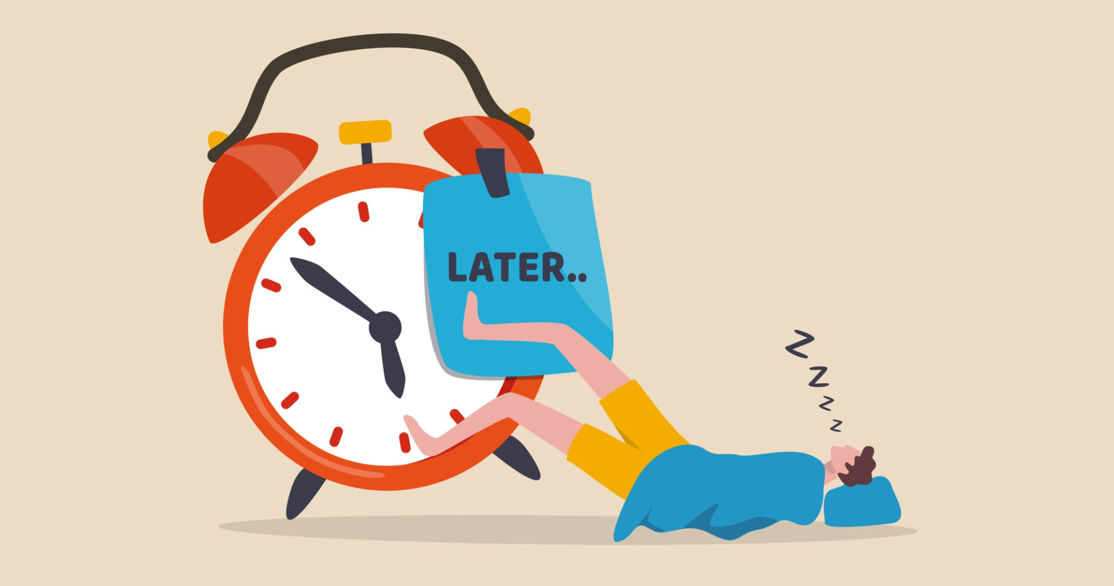
20%
Of adults are chronic procrastinators
80~
95%
Of college students procrastinate
14-to-29-year-olds procrastinate the most
Image Source
Notes:
What is Procrastination? Procrastination is the action of putting unpleasant tasks off to be done later, and instead distracting yourself with other activities, which can be playing games, reading messages, watching YouTube, or even working on other projects. Procrastination is surprisingly common among us - around 20% of adults are chronic procrastinators, and a whopping 80-95% of college students procrastinate. A 2016 study that analyzed procrastination in several different age groups found that procrastination was highest in 14-to-29-year-olds, the youngest age group studied.

Slide 3
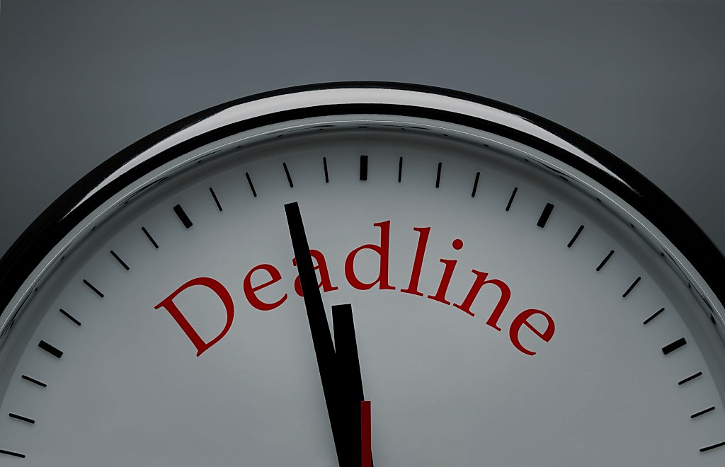
Types of Procrastination
Active procrastination
Passive procrastination
Intentional, Deliberate
Work more efficiently under pressure
Know that you can finish it on time
Might be beneficial
Unintentional
“I’ll start tomorrow”
Distracted by more enjoyable activities
Temporary stress/anxiety relief
Negative impact on performance
Image Source
Notes:
It is important to know that there are actually 2 main types of procrastination - active procrastination, and passive procrastination. Active procrastination is when you deliberately procrastinate, and you know that you work more efficiently under pressure. An example would be how even though I knew about the TED talk project before the winter break, I only started it a week before the due date, but I was able to focus and work productively. Active procrastination can be beneficial only if you are sure you will be able to finish it on time, but once it's done, you can just turn it in and no longer worry about it.
On the other hand, passive procrastination is unintentional - you want to start working, just not immediately, and in the meantime you distract yourself with other activities to not think about it. This would be more like what I did with my speech last year, when even though I knew the speech was next week, or even tomorrow, I just watched YouTube anyway, and wrote 70% of the speech at 12 AM, and the rest AT SCHOOL ON THE DAY OF THE PRESENTATION. My speech was horrible, but somehow I managed to get a decent mark. This is a good example of passive procrastination because unintentional - you want to start the assignment, but you find yourself off-task. The reason for passive procrastination is that it gives us a temporary relief from anxiety, but the anxiety returns right before the due date, and sometimes you never finish the task.

Slide 4

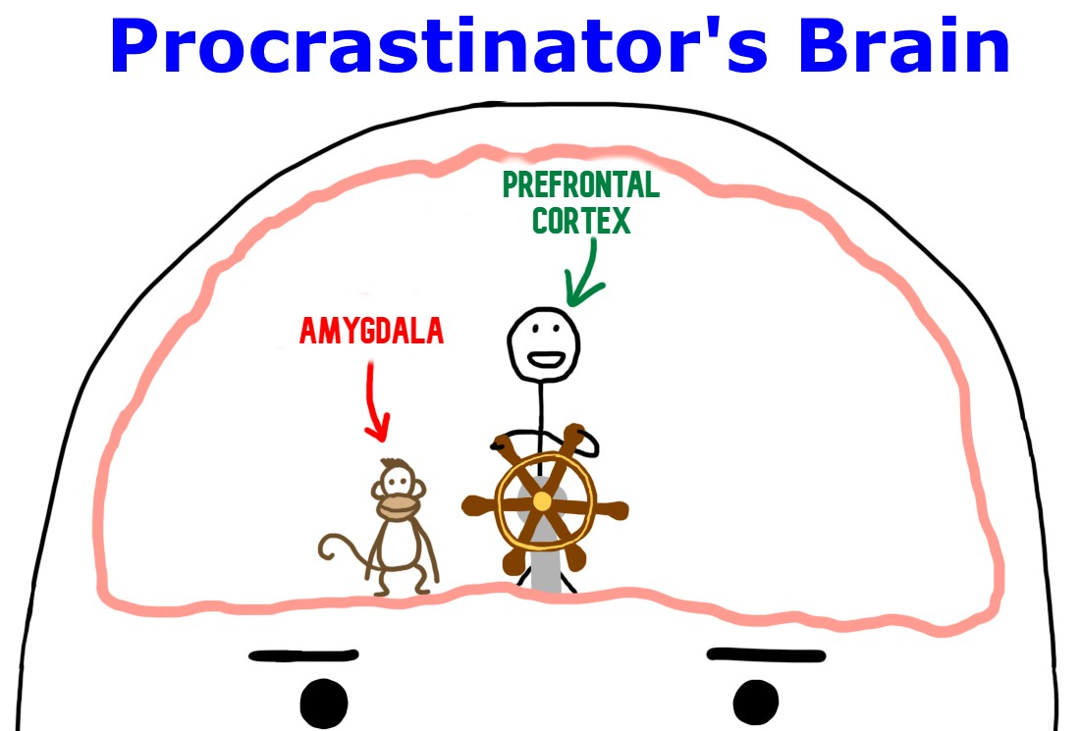
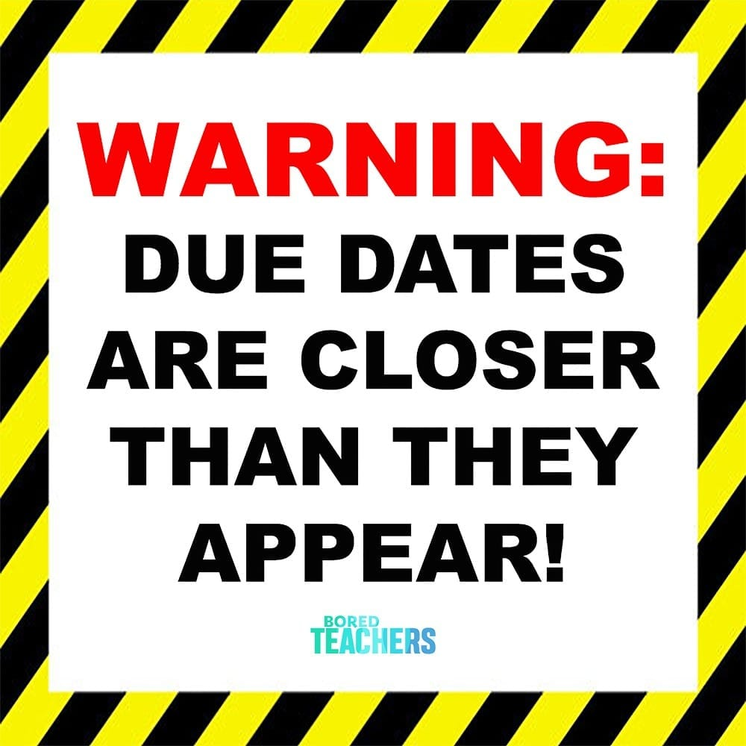
(but more scientifically accurate)
80~95% of people’s
Maybe you should check Discord first.
You should really start the assignment when you still have time.
Not the assignment! Please, No!
Image Source
Notes:
But why do we procrastinate, even when we know that we shouldn't? When procrastinating, you know that you must start the assignment, yet you continue watching YouTube, checking messages, or even working on other assignments. Why is this? Procrastination is actually the result of your body trying to protect you. When there is a difficult or unpleasant task at hand, your brain gives you a sense of fear or dread to prevent you from completing it. Your amygdala, the part of your brain responsible for emotions and fear, releases adrenaline hormones and overpowers the prefrontal cortex, the part of your brain responsible for making rational decisions. The amygdala wants to keep you safe and happy, which it thinks is more important that getting your work done. This is what's happening when you sit down and start to work on something, and a few minutes later, you're off task… again.

Slide 5
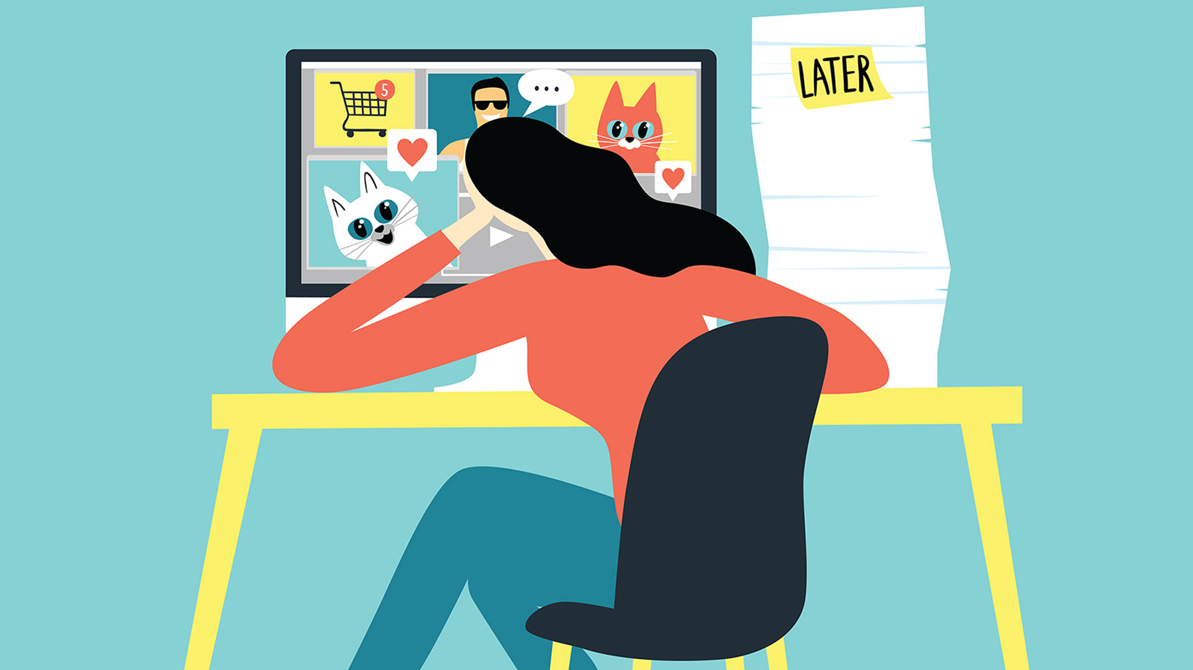
Ways to Stop Procrastinating
Turn off phone
Close unnecessary/distracting apps
Turn off notifications
Set goals and estimate time limits
Work on harder homework before easier homework, before more “fun” activities.
Don’t get distracted with rewards.
Notes:
Speaking of getting work done, how do we stop procrastinating? We procrastinate by distracting ourselves with other activities, so the easiest way to prevent procrastination is to remove these distractions. Put away your phone, close all open apps other than ones that you need for the assignment, and turn off your notifications. You will probably be too lazy to wait for Discord to reopen, and you'll just do your work. Setting realistic goals and estimating the time for them also helps, and I have found it helps me finish my work faster. This works because it gives you an idea of how much you should accomplish in a given amount of time. Many people say that a reward can be used to motivate you, but when it comes to tasks that involve more thinking, the reward can actually distract you and slow you down, as you are thinking more about the reward than the task. My last tip is not one I have found through research, but one I have noticed in my own experience - get the work done first. When I work on homework before playing games, I work faster and more efficiently in the same time than if I play games first. This may happen because your brain finds it easier to transition from a task you dislike to one that is more enjoyable, and finds it harder to transition from an easy task to a hard one.

Slide 6
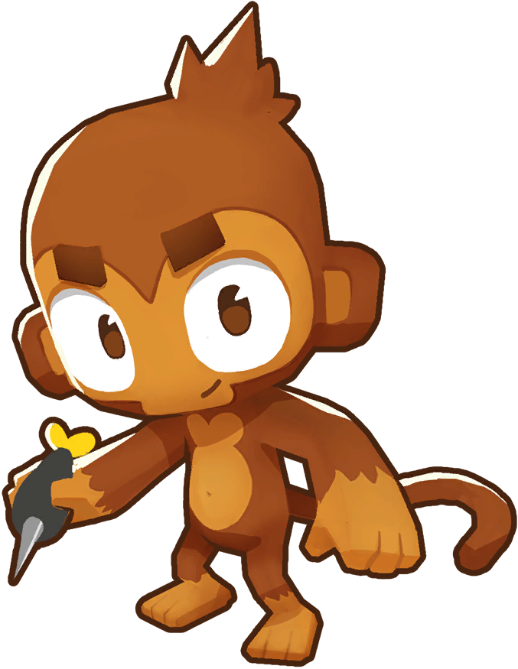
Procrastination benefits?
Working under pressure can make you work faster and more efficiently.
Gives you time to take a break
Makes other tasks feel easier
Notes:
I've talked a lot about how procrastination can have negative effects, but can procrastination actually be beneficial? Procrastination can lead to anxiety, depression, or many other problems, but surprisingly, there are a few benefits to procrastination. As I said earlier, active procrastinators prefer to work under pressure and know that they can get their work done on time. “Urgency can lead to you getting into a state of hyperfocus—or flow—where many people do their best work,” -Quote from outsideonline.com . Procrastination can also give you a chance to take a break, and most of your creative ideas actually come from your free time. Pushing yourself to do a task can actually slow you down if you have been working on it for too long. Procrastination can also make other tasks easier - if you are procrastinating over one big project that you really don't want to do, you may find it easier to work on other smaller tasks compared to the big project.

Slide 7
Notes:
In conclusion, procrastination is a major issue in our everyday lives, and can result in poor grades, many overdue tasks, and missing out on opportunities. There are 2 main types of procrastination - passive procrastination, which is unintentional and is a temporary stress-reliever, and active procrastination, which is intentional and can even be beneficial. Procrastination is normal, and does NOT mean you have ADHD, even if your parents tell you that. We procrastinate because our brain is trying to keep us safe from an unpleasant task. You can stop procrastinating by removing distractions, setting goals, and doing challenging or unpleasant tasks before more enjoyable ones. In some cases, moderate procrastination can be beneficial, as the pressure of a nearing due date can help you focus, and taking a break can refresh your brain and even boost creativity. Now that you know all the untold truths about procrastination, I hope you are able to do your homework more efficiently. Thank you.

